Slide 1




PAYMENTS RE-IMaGINATION
Merchant Acquiring
International
&
Trade Payments
Domestic Payments

Slide 2










Merchant Acquiring LIFE CYCLE

MPM
POP
Merchant Pricing
RCU
TMS
Merchant on-boarded

Straight through Process
MCD
CTS
Dispute & Chargeback

New Merchant and Terminal details added
Terminal in ready state
CBA TMS
INGENICO TMS
DAISY

CTS
Send feed to Omnia
AppBank
Marcia

Process and store the data
RCU

Terminal installed at merchant location

Feed utilized for chargeback
POP – STP


Download software & Parameters
Dispute Management

Download required apps and perform logons
Pricing, Billing & Statement
MOVE5000
eHub Int.

Send data for pricing & Billing
M&M
CTS
CTS
RCU


Process & Validate card payment
CNX
Perform pricing and Billing activities
SAPCC
Dailogue

Card & Balance Check
BPH

Generate customer & Merchant statement

Switching & Authorization
Everyday Settlement
DailyIQ
Real time Fraud check
RTTM

Debit or credit Posting
SAP
RCU

Customer reporting

Run and process transactions in batch
Reconciliation & Reporting

Generate Regulatory Reports

Merchant & Customer Settlement
CRS
DARE

Financial & Technical reconciliation

Settlement completed
RCU
CTS
Interchange (eftpos) and RBA Settlement

GL Posting
PAYMENT JOURNAL
CTS
RCU

Slide 3


Merchant Acquiring - Challenges
ACQUIRE
MANAGE
OPERATE
SUPPORT
Merchant Acquisition
Merchant Management
Product Operations
Support
Product Pricing
Authorise Payments
Manage Assests
Statements
MCD
MPM
CTS
CNX
RCU
CBA TMS
Ingenico TMS
RCU
Dailogue
BPH
SAP
Onboard Merchant
Dispute & Chargebacks
Regulatory Reports
POP
CTS
TMS
Manage Merchant Account
Daisy
Marcia
RCU
RCU
CTS
DARE
RCU
Appbank
CTS
RCU
SAP
Settlement
Customer Reports
CTS
RCU
CRS
Manage Fraud Monitoring
RTTM
Billing
Management Reports
SAPCC
RCU
CTS
RCU
*16 Systems consolidated to single platform
ISG – GENIUS/Openway Payment Hub
Merchant Onboarding
Pricing & Invoicing
Merchant Portal
Terminal Management
Transaction Switch
Settlement & Reconciliation
Dispute & Chargeback

Slide 4
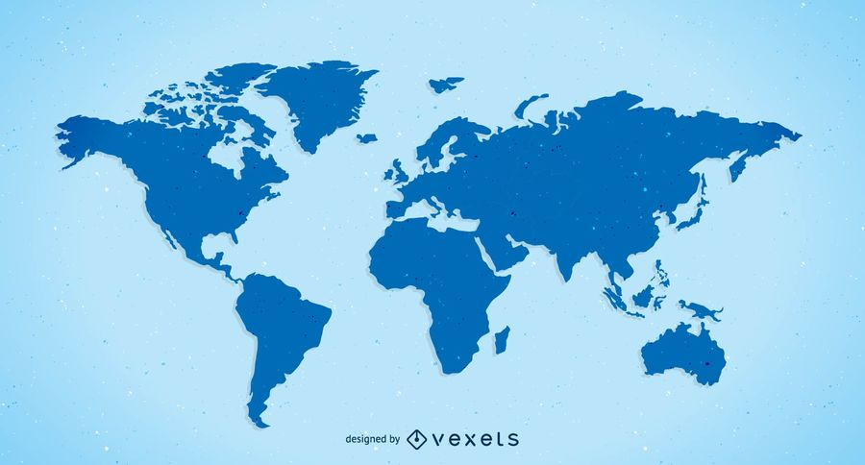

INTERNATIONAL payments
Credit account
SWIFT Network (AMH)
Credit the account of beneficiary
AMH will rout the transaction to SWIFT network
Sanction check (Fircosoft)
Validation of Sanctions based on strategic rules defined in Fircosoft
Debit account (SAP)
In case remitter is CBA account, debit posting initiated
Validate (BPH)
Transaction validation by checking format of message fields
$
IMTs initiated via NetBank
STP Process (STP)
Data for Austrac (SDS)
Transaction undergoes straight through processing checks
Payment Management (PMS)
Log entries in SWIFT Data Store (SDS) for generating IFTI reports to Austrac
Payment Orchestration and Liquidity Management

Slide 5
trade payments (via Murex)
Trade placed
SWIFT Processing (AMH)
Trade is processed via SWIFT
Payments (BPH & PMS)
Payments processing and orchestration
Risk (CRLS)
Generate Risk report (Derivatives and FI)
€
Trades Initiated via
Murex - Derivatives & FI

Slide 6
ACHIEVEMENTS
VALUE PROPOSITIONS
PMS Replacement
AMH Migration
Migration of RTGS to Clearing Mediation Layer
Migration of IMT to international transfers mediation layer
ASB Integration
Functionalities migrated to AMH without SWIFT consultancy
Integrated ASB with CBA Systems
A&I
Advanced analytics to increase STP (CBA STP- 83%)
Reduce Risk – Predictive analytics on Fraud transactions
BWA Merger
SWIFT Standards
BW Applications integrated with CBA Applications as part of merger
Standards built without SWIFT consultancy

Slide 7
Domestic payments
Challenges
1
Number of payments services cause significant risk and cost profiles for payments platform
Product System
Channel
Product System
Channel
2
Non-rationalization of existing processes and system integrations
3
Increased complexity and increased technical debt
Mediation
Integrated Payment Service
Mediation
Payment Systems
Advantages
1
Standard set of APIs that can be leveraged by new or existing applications
Payments are processed via multiple payments applications (20) Ex:-
IFW
BPH
AMH
DE
Cheque processing
Payment Service comprises of below components which will enable Payments as service and will align to Payments as an utility
NPP
CBIS
POM
CLML
Sterling
2
Mediation layer acts as facade for existing processing and system integration methods that also leverages APIs
3
Migration of legacy IT Assets and extension for international Payments

